Slide 1
Project: Sudoku (LAN)
Version 1
Created by: Kh.Serikjan (IT 3-1), B.Batkhuu(IT 3-1)

Slide 2
Contents
Introduction
Demo version & GUI design
Design decisions
Errors and tests
Plan of version 2
Future plan

Slide 3
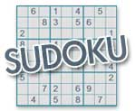
Introduction
Sudoku is a logic-based, combinatorial number-placement puzzle. The objective is to fill a 9×9 grid with digits so that each column, each row, and each of the nine 3×3 sub-grids that compose the grid (also called "boxes", "blocks", "regions", or "sub-squares") contains all of the digits from 1 to 9.

Slide 4
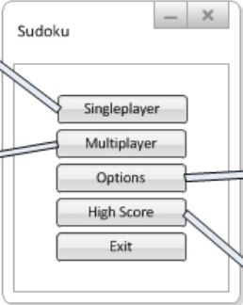
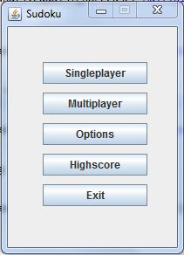
Demo version & GUI design
Main window:

Slide 5
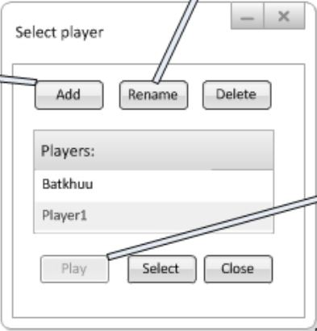
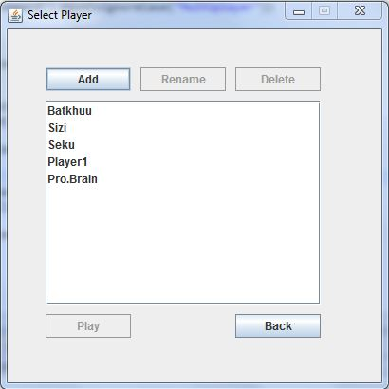
Demo version & GUI design
Select player window:

Slide 6
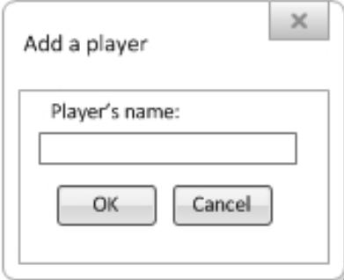
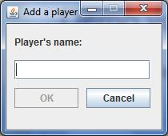
Demo version & GUI design
Add a player dialog

Slide 7
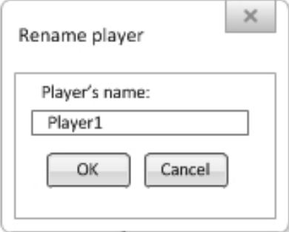
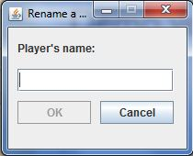
Demo version & GUI design
Rename a player dialog

Slide 8
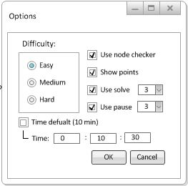
Demo version & GUI design
Options window:
It will be soon…

Slide 9
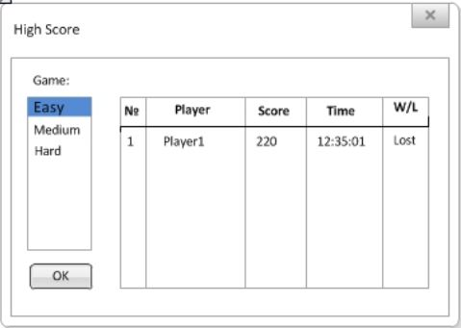
Demo version & GUI design
High Score window:
It will be soon…

Slide 10
Design decisions
Each player can see the opponent’s board.
Input options: Mouse and keyboard. Other Sudoku uses only mouse for input.
Not many tools
Simple to use and play
Select or add player in Single mode

Slide 11
Design decisions
Problem:
We need some window, dialog and send some value to other window.
Decision:
Window, dialog must be GUI class
Class extend from JFrame
Send value by class constructor parameter

Slide 12

Design decisions
Implementation:
……………
Result: It works

Slide 13
Design decisions

Slide 14
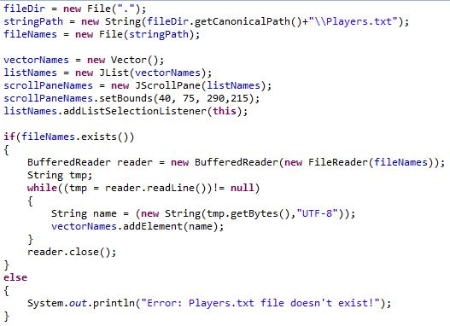
Errors and tests
Init from file:

Slide 15
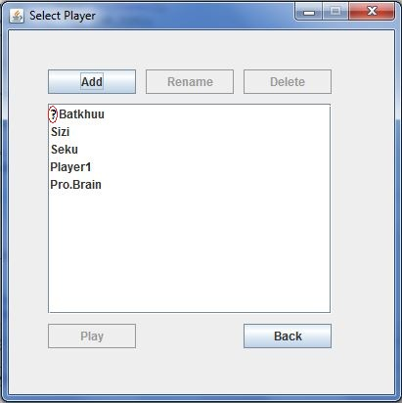
Errors and tests
Init from file:
First time
init from
file there was
a “?” symbol
always show.
Then next
time it was gone.
I didn’t know why?

Slide 16
Errors and tests
Load score from file is hard. How can i decide easily?

Slide 17
Plan of version 2
Recommended:
Options will work from config file
Players score store in file like a array table
Create host and connect
Optional:
Play with other player by LAN
New nice Graphic User design
Use design pattern to good code

Slide 18
Future plan
Develop code to good, big application
Login to online and it will have server to play by internet.
Add more sudoku type like 4x4 etc.
Add skills to more fun
Add more difficult and levels
Exp, coins… etc

Slide 19
Any questions?
Thanks for attention

